Slide 1
Workplace Health Promotion and the Settings Approach
Health and Work Module
Week 3
Tristi Brownett - October 18

Slide 2

Directed Activity
Read Thriving, Striving or Just About Surviving – focus on the different types of workers described; consider what might their health and wellbeing needs be? We will discuss this in brief next week.
Spend time exploring the NHS Employers health and wellbeing webpages in preparation for next week’s lecture: http://www.nhsemployers.org/your-workforce/retain-and-improve/staff-experience/health-work-and-wellbeing. Note what issues are being given attention, the size of the project to address health and wellbeing, how staff are being engaged in the project.

Slide 3
Thriving, Striving or Just About Surviving
Directed activity - focus on the different types of workers described; consider what might their health and wellbeing needs be?

Slide 4


Thriving, Striving or Just About Surviving
Living in poverty
Working long and potentially antisocial hours
May be relying on benefits
May experience fatigue, stress, poor mental and physical health
Unable to access sick pay and holidays
Vulnerable to exploitation and bullying

Slide 5


Thriving, Striving or Just About Surviving
Thriving but vulnerable to sudden loss of work/income resulting in Stress
Worklife balance may be poor
May feel isolated
Probably spending much of income on rent and few opportunities for savings
May experience stress or burnout. May be poor worklife balance

Slide 6


Thriving, Striving or Just About Surviving
Won’t cope well with change
May be drinking more alcohol in the evenings
May experience stress and burnout
Likely to have good social support
Likely to be drinking more alcohol or using substances!

Slide 7

Why is workplace health and wellbeing promotion important?

Slide 8
What CIPD says...
https://youtu.be/iVNcmNp7uT8

Slide 9
Why is workplace health and wellbeing promotion important?
A growing body of research has demonstrated that the support of wellbeing in the workplace has positive impact on staff, business and organisations.
This includes benefits in terms of reduced absenteeism and presenteeism as well as improved productivity.
Evidence from Britain’s Healthiest Workplace, shows that an employee who reports being content with his/her current job has on average 6.92 percentage points less work impairment due to absenteeism and/or presenteeism than an employee who is unhappy with his/her job.
Employees in companies that do not acknowledge health and wellbeing as an organisational success indicator report higher work productivity loss due to absenteeism and presenteeism.
Whitmore et al., (2018, p1) see reading list for full details

Slide 10

Remember this?
“Health is created and lived by people within the settings of their everyday life; where they learn, work, play and love. Health is created by caring for oneself and others, by being able to take decisions and have control over one's life circumstances, and by ensuring that the society one lives in creates conditions that allow the attainment of health by all its members.”
OTTAWA CHARTER FOR HEALTH PROMOTION, 1986

Slide 11

Why is the Ottawa Charter important to the context of health and work?

Slide 12
(Dooris et al., 2007, p330) (Bb)
“Contemporary health promotion programs consist of complex social interventions slotting intentional change efforts into pre-existing contexts. Yet, “whilst programs are initiated in prisons, hospitals, schools, neighbourhoods, and car parks, it is the prior set of social rules, norms, values and interrelationships gathered in these places which sets limits on the efficacy of program mechanisms” (Pawson & Tilley, 1997, p.70). Context, is therefore fundamental to health promotion.”

Slide 13
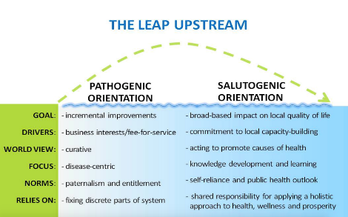
The workplace as a setting for health
For promoting and improving health in the workplace we should consider an ecological perspective:
Moving from individuals to the population as a whole.
From Illness to Salutogenesis
A place of continuing and sustained interaction
Supporting policies and structures
Supporting culture and values
Image from Sharon VanDer Kaay (2011)

Slide 14
Recap from week 1. Definition of a Healthy Workplace
A healthy workplace is one in which workers and managers collaborate to use a continual improvement process to protect and promote the health, safety and well-being of all workers and the sustainability of the workplace by considering the following, based on identified needs:
health and safety concerns in the physical work environment;
health, safety and well-being concerns in the psychosocial work environment, including organization of work and workplace culture;
personal health resources in the workplace; and
ways of participating in the community to improve the health of workers, their families and other members of the community. (Neira, 2010, p6)

Slide 15
The Health Promoting Workplace
WHO Global Healthy Workplace (1997) called for a comprehensive approach with four principles:
Health promotion
Occupational health and safety
Human resource management
Sustainability
Jakarta Declaration (1997)
the importance of social responsibility for health
expanding partnerships for health
increasing community capacity and empowering individuals
securing the infrastructure for health.

Slide 16
Workplace Health Promotion Types in Europe (Chu et al., 2000) (Bb)
as a strategy of behaviour prevention at the workplace (lifestyle approach);
as a part of extended occupational safety and health;
as a strategy to influence important health determinants at work;
as a strategy to reduce absenteeism;
as a part of organizational development.

Slide 17
The Luxembourg Declaration on Workplace Health Promotion in the European Union (1997, updated 2007)
WHP is based on multisectoral and multidisciplinary co-operation and can only be successful if all the key players are committed to it. WHP can reach the aim “healthy people in healthy organisations” if it is oriented along the following guidelines:
All staff have to be involved (participation).
WHP has to be integrated in all important decisions and in all areas of organisations (integration).
All measures and programmes have to be oriented to a problem-solving cycle: needs analysis, setting priorities, planning, implementation, continuous control and evaluation (project management).
WHP includes individual-directed and environment-directed measures from various fields. It combines the strategy of risk reduction with the strategy of the development of protection factors and health potentials (comprehensiveness).

Slide 18
The Luxembourg Declaration cont...
WHP contributes to a wide range of work factors which improve employees’ health. These include:
Management principles and methods which recognise that employees are a necessary success factor for the organisation instead of a mere cost factor
A culture and corresponding leadership principles which include participation of the employees and encourage motivation and responsibility of all employees
Work organisation principles which provide the employees with an appropriate balance between job demands, control over their own work, level of skills and social support
A personnel policy which actively incorporates health promotion issues
An integrated occupational health and safety service.

Slide 19
Barcelona Declaration on Developing Good Workplace Health Practice in Europe (2002)
There is no public health without good workplace health.
To ensure that public health agencies give a high priority to promoting workplace health.
“The world of work, and the way that working life is organised in our societies today, is a major, and perhaps the strongest, single social determinant of health. Individual health practices are shaped by our workplace cultures and values. The increase in mental health disorders can only be understood in the context of increasing psycho-social stressors and strains at the workplaces. Smoking and alcohol consumption are deeply rooted in our daily working life, and can only be tackled through health promoting workplaces, which have incorporated respective policies and values. Workplace health is not confined within the factory walls. The workplace has major impacts on the health of families and communities.”

Slide 20
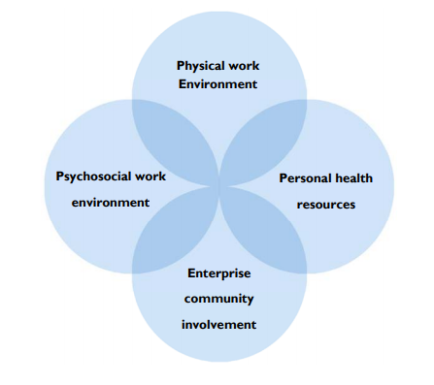
The Avenues of Influence for a Healthy Workplace
(Neira, 2010, p9)

Slide 21
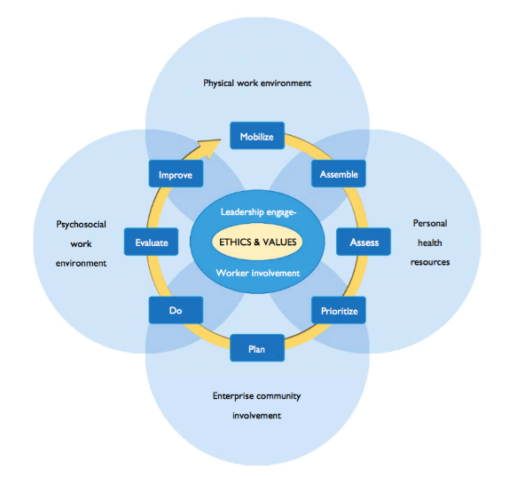
What does workplace health and wellbeing promotion look like?
WHO Healthy Workplace Model (Neira, 2010, p.8)

Slide 22
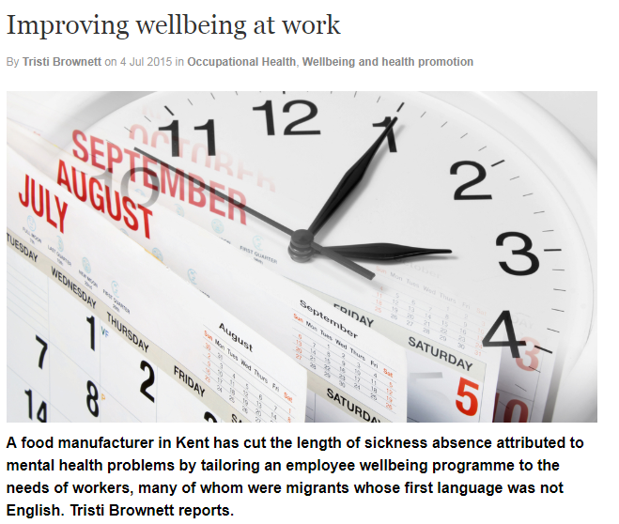


Case Study: Tilmanstone Salads
https://slideplayer.com/slide/8577065/

Slide 23

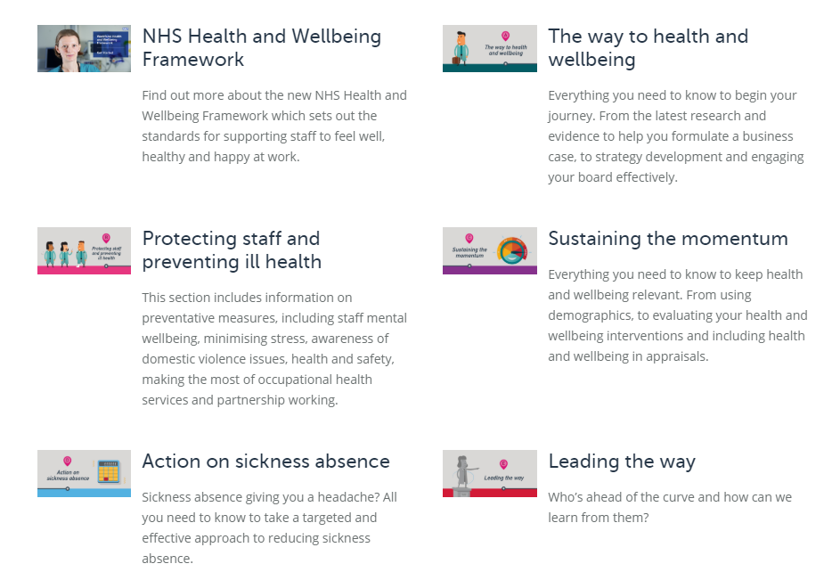

http://www.nhsemployers.org/-/media/Employers/Documents/Retain-and-improve/Health-and-wellbeing/Vital-signs-eight-essentials-May-2018-web.pdf
http://www.nhsemployers.org/your-workforce/retain-and-improve/staff-experience/health-work-and-wellbeing.

Slide 24

Health Promotion Planning Models

Slide 25
Health Promotion Planning Cycle (Naidoo and Wills, 2009)
Identification of need
Identifying target groups, key issues
Setting Aims and Objectives
Intervention
Evaluation
Assess
Evidence
Analyse causes and contributory factors
Identify obstacles and risks in implementation
Resources

Slide 26
Planning Model Flow (Ewles and Simnett, 2003)
1.Identify NEEDS and PRIORITIES
2. Set AIMS and OBJECTIVES
3.Decide the best way of ACHIEVING the AIMS
4. Identify RESOURCES
5. Plan EVALUATION methods
6. Set an ACTION PLAN
7. ACTION! Implement your plan, including your evaluation

Slide 27
Who does workplace health and wellbeing promotion?
OH Advisor
HR Manager
Health and Safety Officer
Unions
Manager
Workplace health champions
Employees

Slide 28
Workplace Health and Wellbeing Charter
The Charter is based on three elements – leadership, culture and communication (required for the initiatives successful and sustainable).
95 Charter standards grouped into eight areas:
leadership,
sickness and absence management,
health and safety
mental health
smoking and tobacco
physical activity
healthy eating,
alcohol and substance misuse.

Slide 29
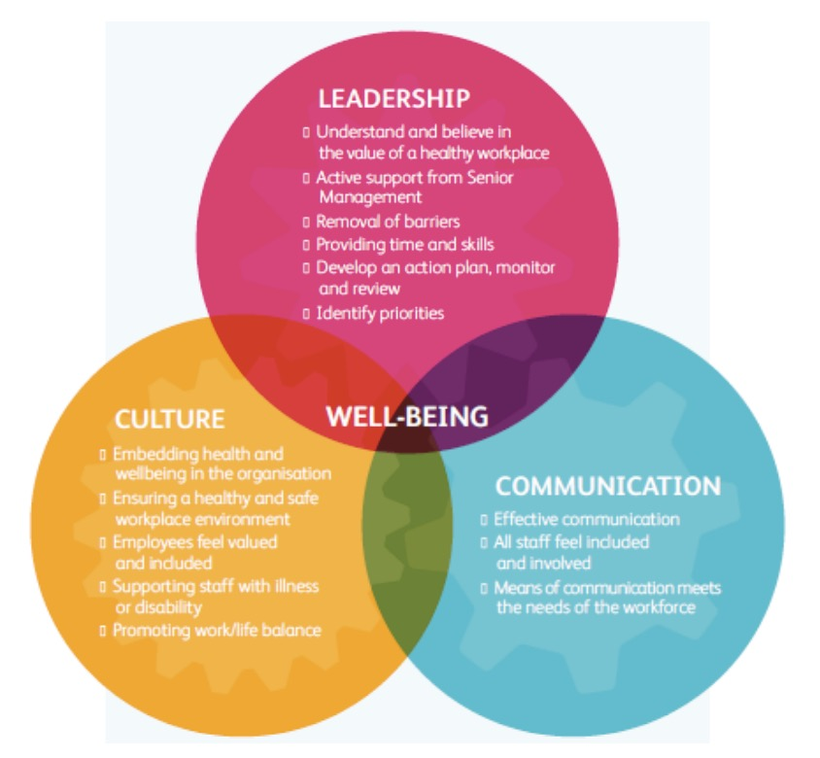
Hoffman et al., 2017, p6 (see Bb)

Slide 30
Workplace Health Champions

Slide 31

What Skills are required?

Slide 32
Programme Evaluation
Effectiveness: does this work?
Process of service delivery: how does this work?
Salience: does it matter?
Safety: will it do more harm than good?
Acceptability: will the target group want to engage with the intervention?
Cost effectiveness: is it worth implementing or purchasing this service?
Appropriateness: is this the right intervention for this target group?
Satisfaction with the service: are stakeholders satisfied with the intervention?
Whitmore et al., (2018, p5) see reading list for full details

Slide 33
Why might it not work?

Slide 34
The Exam

Slide 35
Directed Study
Watch: What is Job Quality and How do we improve it? https://youtu.be/P2duNym7J5U
Watch: How to start changing an unhealthy work environment https://youtu.be/eYLb7WUtYt8
Visit the Unhealthy Work Website and read about the Whitehall Studies https://unhealthywork.org/classic-studies/the-whitehall-study/

